Slide 1
Homework 3 Graphics
Justin Ehly
MLII - Wednesday 630p

Slide 2
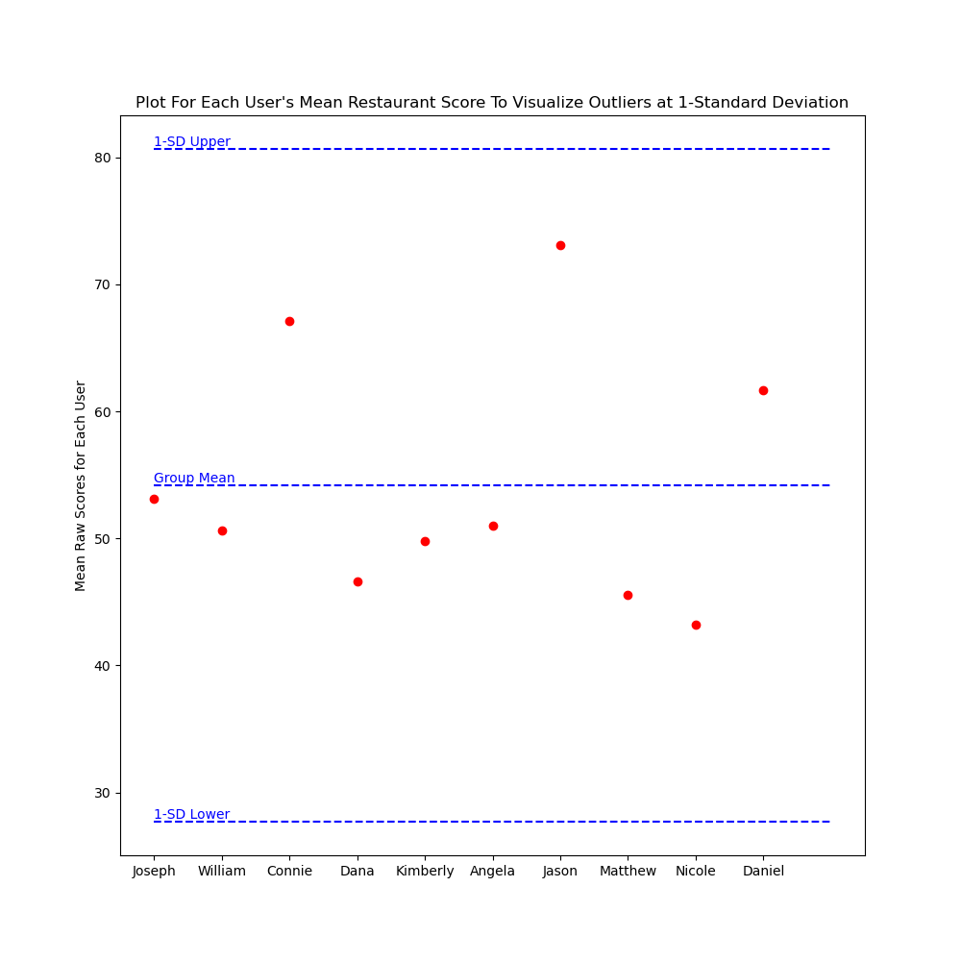
Problem 9 – Using Standard Deviation of 1 to look for dissatisfaction within the group
# graph the mean for each person
x = np.array([y for y in range(len(M_usr_x_rest_avg))])
y = M_usr_x_rest_avg
fig, ax = plt.subplots(1,1,figsize=(10,10))
ax.plot(x, y, 'o', color='red')
ax.hlines(y=[upper, mean, lower], xmin=0, xmax=len(x), colors=['blue'], linestyles='dashed')
ax.text(0,upper, '1-SD Upper', ha='left', va='bottom', color='blue')
ax.text(0,mean, 'Group Mean', ha='left', va='bottom', color='blue')
ax.text(0,lower, '1-SD Lower', ha='left', va='bottom', color='blue')
ax.set_title('Plot For Each User\'s Mean Restaurant Score To Visualize Outliers at 1-Standard Deviation')
ax.set_xticklabels(M_people_names)
ax.set_xticks(x)
ax.set_ylabel('Mean Raw Scores for Each User')
plt.show()

Slide 3
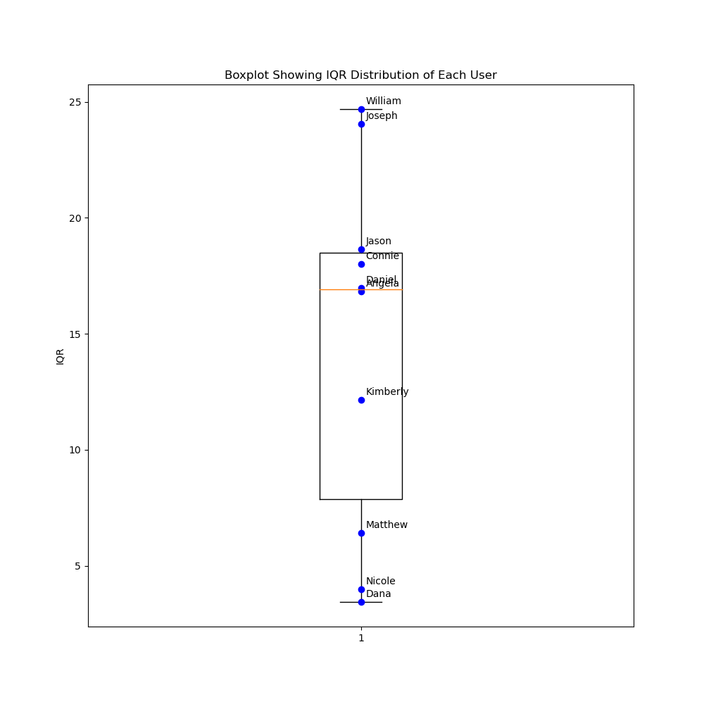
Problem 9 – Using IQR to look for dissatisfaction within the group
# Chart the IQR for each person
x_plot = [1 for x in range(10)]
fig, ax = plt.subplots(1,1,figsize=(10,10))
ax.boxplot(user_iqr, manage_ticks=True, whis=1)
ax.plot(x_plot, user_iqr, 'o', color='blue')
ax.set_title('Boxplot Showing IQR Distribution of Each User')
ax.set_ylabel('IQR')
for i, n in enumerate(M_people_names):
ax.annotate(n, (x_plot[i], user_iqr[i]), xycoords='data', xytext=(5,5),textcoords='offset points')
plt.show()
'''

Slide 4
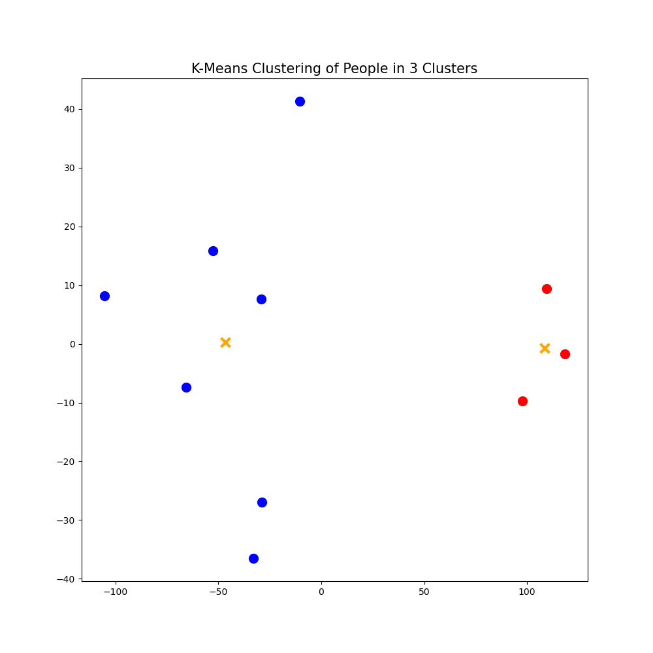
Problem 10 – using PCA/ K-means clustering to determine if the group should split up
# PCA
pca = PCA(n_components=2, random_state=42)
reduced = pca.fit_transform(M_usr_x_rest)
print(pca.explained_variance_ratio_)
print(pca.singular_values_)
pca.get_params()
# KMeans
kmeans = KMeans(n_clusters=2, random_state=42) # set number of clusters
kmeans.get_params() # just curious what the params are
kmeans.fit(reduced) # fit kmeans
kmeans_group = kmeans.predict(reduced)
kmeans_group
labels = kmeans.labels_
labels
# plot results
fig, ax = plt.subplots(1,1, figsize=(10,10))
colors = ['b','r','g']
ax.set_title('K-Means Clustering of People in 3 Clusters', size=15)
print('Location:','\t\t\t','Class Label')
for i in range(len(reduced)):
ax.plot(reduced[i][0], reduced[i][1],'k.', color = colors[labels[i]],
markersize=20)
centroids = kmeans.cluster_centers_
plt.scatter(centroids[:,0], centroids[:,1], marker='x', s=100, linewidths=3,
color='orange', zorder=10)
plt.show()

